Slide 1
IT2757
Server and Services Security Management
- SERvER TECHOLOGY AND CONCEPTS

Slide 2
Server Operating Systems
Server OSes are designed from the ground up to provide platforms for multi-user, frequently business-critical, networked applications. As such, the focus of such operating systems tends to be security, stability and collaboration, rather than user interface.
Server OSes provide a platform for multi-user applications, and most come bundled with a batch of common server applications, such as Web servers, e-mail agents and terminal services.

Slide 3
Server Operating Systems
Features of Server OSes includes:
  GUI not available or optional
  Ability to reconfigure and update both hardware and software to some extent without restart
  Advanced backup facilities to permit regular and frequent online backups of critical data
  Flexible and advanced networking capabilities
  Tight system security, with advanced user, resource, data, and memory protection

Slide 4
Server Services
A network service is an application that provides data storage, manipulation, presentation, communication or other capability which is often implemented using a client-server or peer-to-peer architecture based on network.
Each service is usually provided by a server component running on one or more computers (often a dedicated server computer offering multiple services) and accessed via a network by client components running on other devices. However, the client and server components can both be run on the same machine.

Slide 5
Server Services
Application server, a server dedicated to running certain software applications
Catalog server, a central search point for information across a distributed network
Communications server, carrier-grade computing platform for communications networks
Database server, provides database services to other computer programs or computers
File server, provides remote access to files
Mail server, handles transport of and access to email
Name server or DNS
Print server, provides printer services
Proxy server, acts as an intermediary for requests from clients seeking resources from other servers.
Web server, a server that HTTP clients connect to in order to send commands and receive responses along with data contents
Game server, a server that video game clients connect to in order to play online together

Slide 6
GENERAL CONCEPT – cLIENT/SERvER COMPUTING MODEL

Slide 7
Extending THE MODEL

Slide 8
EMAIL SERVICE

Slide 9
Server Services – how they work
You need a service or application or process running
  E.g. Database server, Email server
You need an address to locate the server running the service
  E.g. IP Address
You need a port number that the service is listening request from
  E.g. Port 80/8080 for HTTP requests
You need a protocol for communicating and exchanging information
  E.g. HTTP, RPC

Slide 10
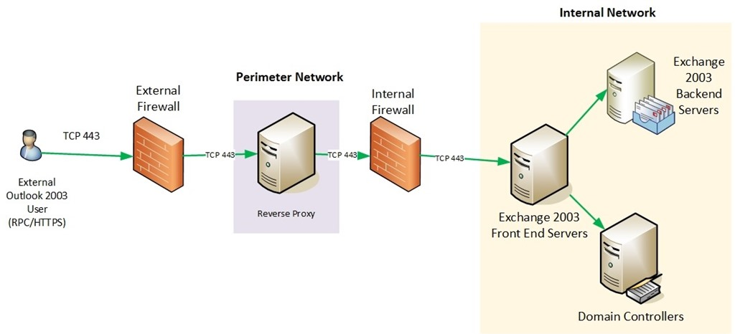
NETWORK ARCHITECTURE
192.168.1.100

Slide 11
SECURITY Vulnerability
Vulnerabilities can exist throughout the chain of information:
  Application vulnerability
  Common ports (expose the process running)
  IP Address (spoofing..)
  Protocol (how to manipulate, hack the protocol, listening..)

Slide 12
NEED HOST BASED DEFENCES AGAINST ATTACKS
Host based firewall
Change ports
Application Control
Encryption
Logs

Slide 13
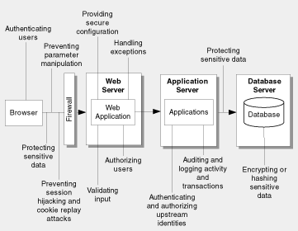

Slide 15
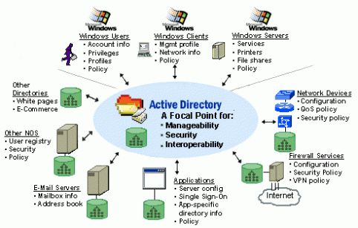
Active Directory

Slide 16
Introduction to Active Directory
Definition
Benefits
User Authentication & Security
NYP Logon Services
Notes:
BIND -

Slide 17
Definition
Active Directory is a system which supports:
  A single sign-on environment via the UmassD Logon
  Improved desktop security
  Improved management and administration of workstations
  Consolidation of servers
  Improved timeframe for updates, patches and installation of new versions of software
  Quicker support call resolution via Remote Desktop Management

Slide 18
Benefits
Access to shared central network disk storage
Ability to share data within departments via departmental shares
Access to personal storage on a centralized secure server
Regular backup of data placed on centralized network disk storage
Easier, searchable access to network services (printers, file servers, etc.)
Centralized support for servers
Remote software installation allowing for more timely software upgrades, patches, and updates
Notes:
Backups nightly, data retained for over 30 days on and off site

Slide 19
User Authentication & Security
Your NYP Logon (Email username and password) will now provide access to even more resources including your computer so the level of security required for this account has increased.
Password Requirements for Security purposes
  Minimum of 10 characters
  At least one Upper Case Letter
  At least one Lower Case Letter
  At least one Number
  Password will expire every 180 days

Slide 20
NYP Logon Services
Services which use the NYP Logon
  Computer Logon (After Active Directory Implementation)
    Shared Network Storage (Connection via Computer Logon)
  Student Portal
    Email
    Statement of Absence
    Results

Slide 21
THE END

